Slide 1

IRIS BIOMETRIC RECOGNITION

Slide 2
OUR TEAM
Phú Hữu Chí Trung
519H0250
Nguyễn Xuân Sơn
519H0228
Nguyễn Tuấn Anh
519H0136

Slide 3
01
04
Pros & Cons Of Iris Recognition
About Biometric
02
05
Security Scenario
About Iris Recognition
03
06
Applications Of Iris Recognition
How It Work?
Table of Content

Slide 4
01
About Biometric

Slide 5

What is Biometric?
Biometrics are body measurements and calculations related to human characteristics.

Slide 6
What is Biometric?
Biometric identifiers are the distinctive, measurable characteristics used to label and describe individuals. Biometric identifiers are often categorized as physiological characteristics, which are related to the shape of the body.

Slide 7
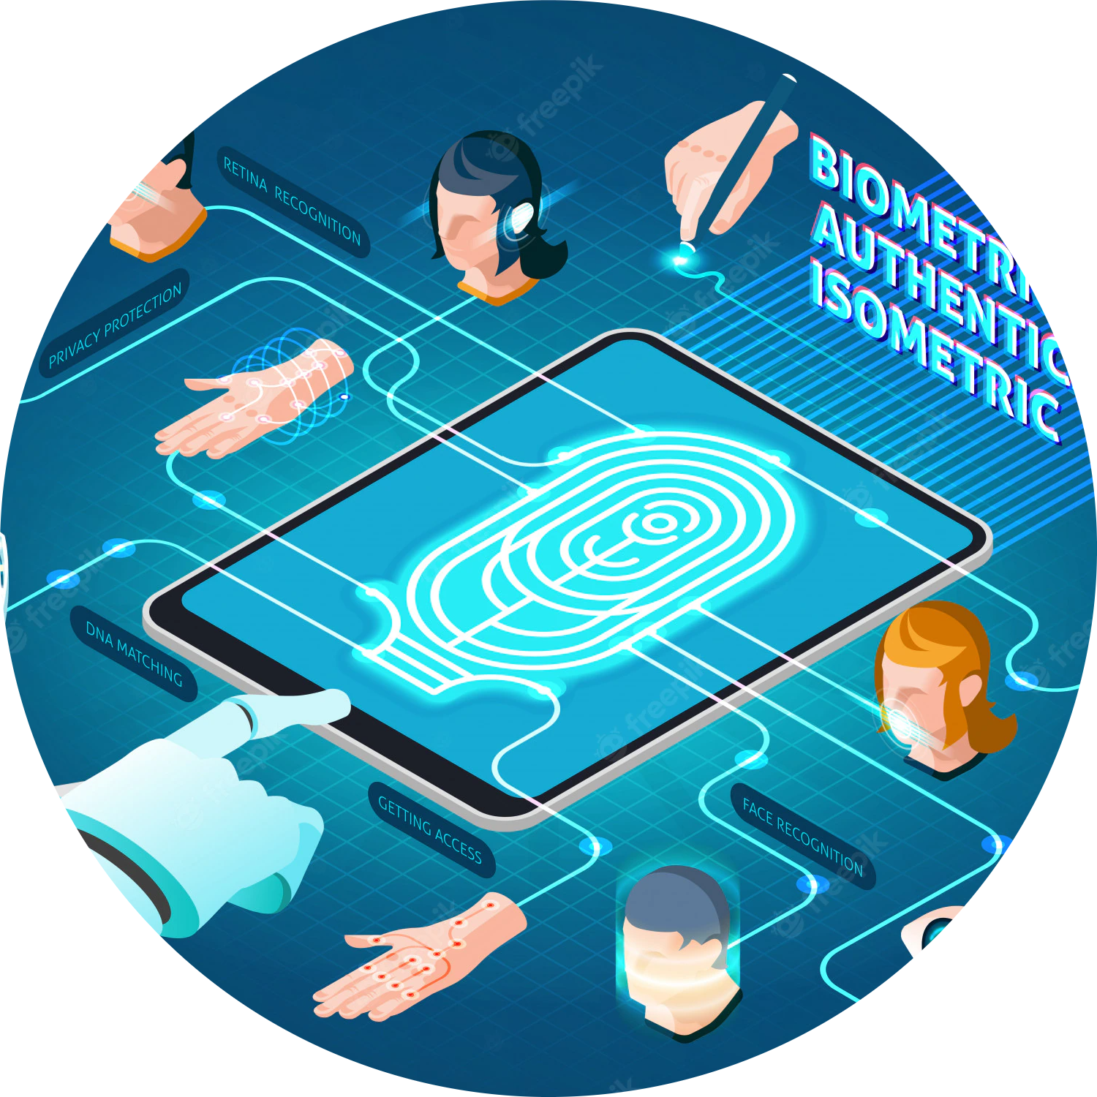
History of Biometric?
Fingerprinting followed suite in the 1880s, not only as a means of identifying criminals but also as a form of signature on contracts. It was recognized that a fingerprint was symbolic of a person’s identity and one could be held accountable by it. Through there are debates on who exactly instigated fingerprinting for identification, Edward Henry is denoted for the development of a fingerprinting standard called the Henry Classification System.

Slide 8
History of Biometric?
1960
1969
1980
1985
1991
2000
Semi-automated facial recognition methods were developed requiring administrators to analyze facial features within an image and extract usable feature points. Much more manual than the ones we can use to open out phones!
The National Institute of Standards and Technology developed a Speech group to study and push forward the processes for speech recognition technology. These studies are the basis for the voice command and recognition systems we use today.
Facial detection technology was developed making real time recognition possible. While these processes had many faults, it skyrocketed interest in face recognition development.
Hundreds of biometric authentication recognition algorithms were functional and patented within the USA. Biometrics were no longer being implemented in just large corporation or a government setting. They were sold in commercial products and were implemented at large scale events like the 2001 Super Bowl.
Fingerprint and facial recognition was so widely used in law enforcement, the FBI put funding towards developing automated processes. This was a catalyst for the development of more sophisticated sensors for biometric capture and data extraction.
The concept that much like fingerprints, irises, were unique to everyone was proposed and by 1994, the first iris recognition algorithm was patented. In addition, it was discovered that blood vessels patterns in eyes were unique to everyone and were used for authentication as well.

Slide 9
02
About Iris Recognition

Slide 10
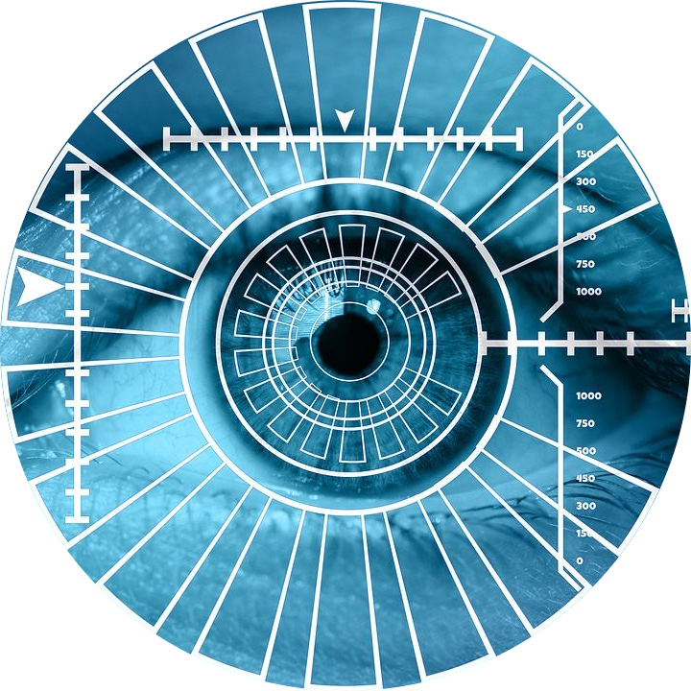
What is Iris Recognition?
Iris recognition is an automated method of biometric identification that uses mathematical pattern-recognition techniques on video images of one or both of the irises of an individual's eyes, whose complex patterns are unique, stable, and can be seen from some distance.

Slide 11
Features of iris recognition?
As long as the eyes are exposed, iris recognition can be used even when the subject is wearing a hat, mask, eyeglasses or gloves.
Highly accurate and fast, iris recognition boasts of having top-class precision among different types of biometric authentication technologies.
Because of using an infrared camera, recognition is available even at night or in the dark.
Remains unchanged throughout life. (This does not constitute a guarantee.)
Without the need to touch the device, contactless authentication is possible, making it hygienic to use.
Since the iris is different between the left and right eye, recognition can be performed separately by each eye.
Possible to distinguish twins.

Slide 12
History of Iris Recognition?
1936
1985
1987
1993
1994
1995
2005
Dr. Flom approached Dr. John Daugman to develop an algorithm to automate identification of the human Iris.
The broad patent covering the basic concept of iris recognition expired, providing marketing opportunities for other companies that have developed their own algorithms for iris recognition. The patent on the IrisCodes® implementation of iris recognition developed by Dr. Daugman (explained below) will not expire until 2011.
Ophthalmologist Frank Burch proposed the concept of using iris patterns as a method to recognize an individual.
Dr. Daugman was awarded a patent for his automated iris recognition algorithms.
The first commercial products became available.
Drs. Leonard Flom and Aran Safir, ophthalmologists, proposed the concept that no two irides are alike, and were awarded a patent for the iris identification concept.
The Defense Nuclear Agency began work to test and deliver a prototype unit, which was successfully completed by 1995 due to the combined efforts of Drs. Flom, Safir, and Daugman.

Slide 13
03
HOW IT WORK?

Slide 14
How Iris recognition work?
To conduct an eye scan, the technology used for the scan directs infrared light into the eye at wavelengths smaller than visible light. These wavelengths allow the scanner to see more delicate patterns in the iris consisting of approximately 240 different features that, together, comprise a unique digital representation of the user
The scanned data is encoded into a machine-readable form for future reference

Slide 15
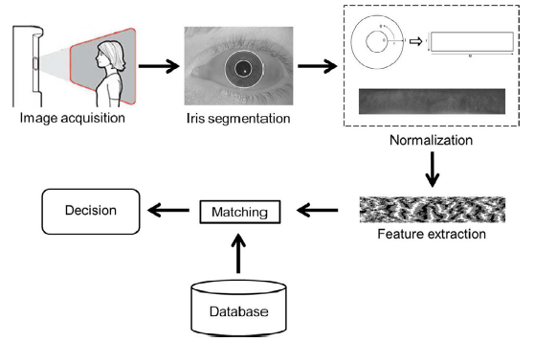


Iris Recognition Process

Slide 16
04
PROS & CONS OF IRIS RECOGNITION

Slide 17
Pros of Iris Recognition
High scalability as it is ideal for handling large databases
Best search speeds among biometric authentication technologies
High levels of safety against identity theft
Iris recognition technology is high in user convenience

Slide 18
Cons of Iris Recognition
Short distance
Iris scanning becomes difficult when there is a lot of movement
It has a high cost
Can’t use a regular camera

Slide 19

05
Security Scenario

Slide 20
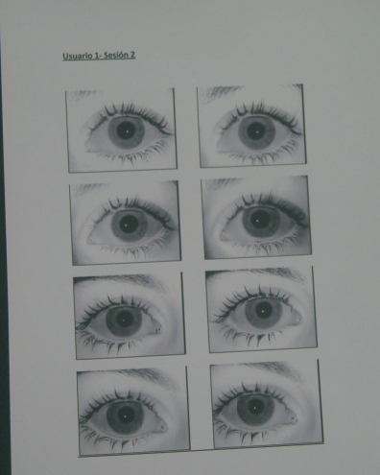
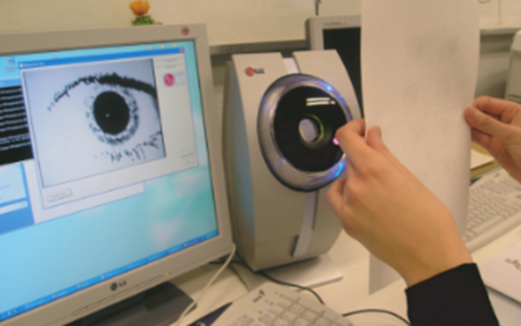
Security scenario of iris recognition
Direct attacks using fake images in iris verification

Slide 21
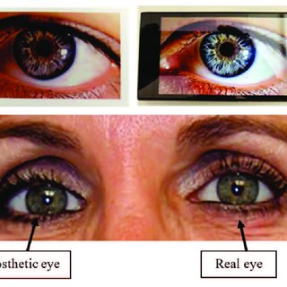
Security scenario of iris recognition
Direct attacks using a contact lens over the iris of the printed image to simulate the surface curvature of a real eye.

Slide 22

Security scenario of iris recognition
So is it possible to use the dead person's iris to access their own data by scanning the iris?

Slide 23
06
Applications Of Iris Recognition

Slide 24
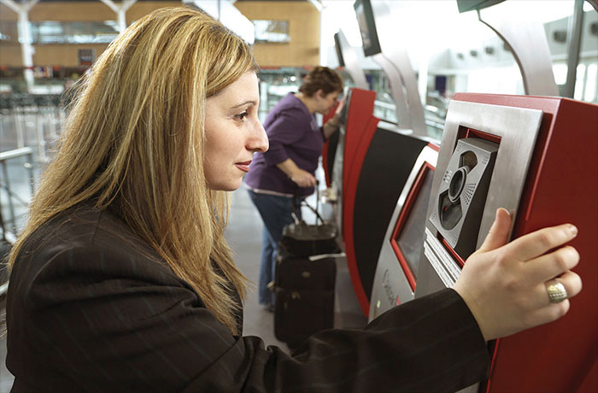
Applications Of Iris Recognition
Finance and banking
Iris recognition technology is being used in banks and financial organizations, replacing the cumbersome and time taking, pin based, and password-based systems.
Since banks generally crunch large amount of financial data and witness a large number of footfalls, data security assumes critical importance

Slide 25
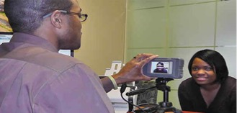
Applications Of Iris Recognition
Healthcare and welfare
Iris recognition technology provides an option to identify proper insurance status that prevents fraudulence and duplicate medical records
No more patient harm due to wrong identification, zero fraud by patient identity theft

Slide 26
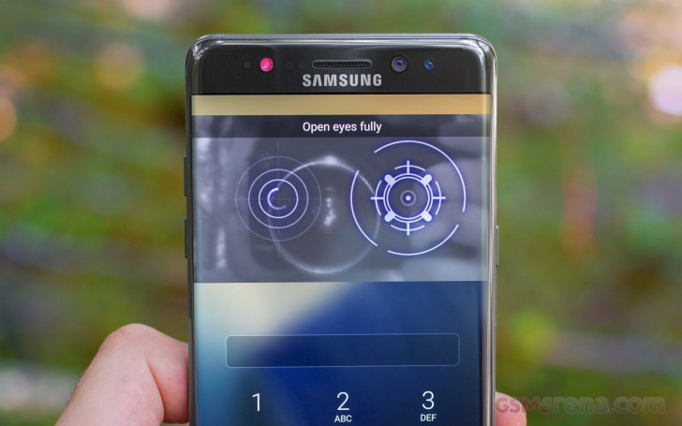
Applications Of Iris Recognition
Smartphone and mobile devices
The application of iris scanning to replace traditional fingerprint recognition not only enhances security but also enhances user experience.

Slide 27
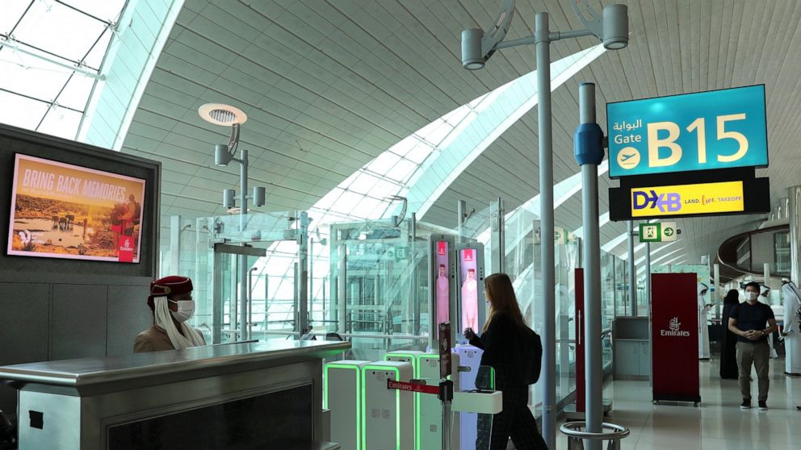
Applications Of Iris Recognition
Iris Passport
Dubai's airport started offering the program to all passengers in 2021. Travelers stepped up to an iris scanner after checking in, gave it a good look and breezed through passport control within seconds. Gone were the days of paper tickets or unwieldy phone apps.

Slide 28
Thank you!

Slide 29
Reference
Advantage of iris recognition: https://www.bayometric.com/biometric-iris-recognition-application/
Some application of iris recognition: https://www.bayometric.com/biometric-iris-recognition-application/
Application : https://www.fierceelectronics.com/components/iris-scan-security-for-smartphones-and-mobile-devices
https://projet.liris.cnrs.fr/imagine/pub/proceedings/ICPR-2010/data/4109b217.pdf
https://www.technologyreview.com/2018/07/24/141323/iris-scanner-can-distinguish-dead-eyeballs-from-living-ones/
https://www.researchgate.net/publication/329936553_Introduction_to_Iris_Presentation_Attack_Detection
https://www.researchgate.net/figure/Iris-recognition-system-5_fig2_349073977
https://en.wikipedia.org/wiki/Iris_recognition
https://www.nec.com/en/global/solutions/biometrics/iris/index.html

